Slide 1
Lecture 4 Entity-Relationship Model Extended Features
Aggregation
Weak Entity Sets
Generalization and Specialization

Slide 2
Outline
Aggregation
Weak Entity Sets
Generalization and Specialization
Aggregation
Weak Entity Sets
Generalization and Specialization

Slide 3
Aggregation
Aggregation
Weak Entity Sets
Generalization and Specialization
In the last lecture, we saw the example to constraint ternary relationship sets.
But there were some constraints which were not discussed.
Recall the ternary relationship set and the constraints.
One course is instructed by at most one instructor.
One instructor can instruct at most one course.
One student is associated with at most one combination of instructors and courses.
student
enroll
course
instructor

Slide 4
Aggregation
Aggregation
Weak Entity Sets
Generalization and Specialization
The difficulty in this example is that the ER diagram wants to express two types of constraints at the same time,
a constraint between two entity sets in a multi-ary relationship set, and
a constraint between an entity set and a combination of multiple entity sets.
To handle this issue, ER diagrams use aggregations.
Treat relationship as an abstract entity.
Allows relationships between relationships.
Abstraction of relationship into new entity.
Back to the example, the following design is much better.
course
The abstract entity set
student
enroll
teach
instructor

Slide 5
Aggregation
Aggregation
Weak Entity Sets
Generalization and Specialization
Sometimes, aggregations are also used to remove redundancies.
First, let’s go back to the ternary relationship among “student”, “instructor”, and “course” without any constraint.
This time, we want to model a new entity set, course projects.
Since each course project is supervised by an instructor and done by some students for a particular course, then a quaternary (4-ary) relationship set is reasonable.
project
student
doing
course
instructor

Slide 6
Aggregation
Aggregation
Weak Entity Sets
Generalization and Specialization
However, only one quaternary relationship cannot cover the original relationship set “enroll”.
The two relationship sets are of different meanings.
More importantly, some courses may not have any project.
Thus, the ER diagram also needs “enroll”.
project
student
doing
course
enroll
instructor

Slide 7
Aggregation
Aggregation
Weak Entity Sets
Generalization and Specialization
But this model contains redundancies.
If a student does a project for a course under an instructor’s supervision, this student and the instructor must enroll the course.
Each project must be with an enrollment.
project
student
doing
course
enroll
instructor

Slide 8
Aggregation
Aggregation
Weak Entity Sets
Generalization and Specialization
A better model is let “student”, “instructor”, “course”, and “enroll” form an abstract entity as an aggregation.
Then “project” only need to associate with the courses which has a course project.
instructor
student
enroll
course
doing
project

Slide 9
Weak Entity Sets
Aggregation
Weak Entity Sets
Generalization and Specialization
A weak entity is an entity cannot exist alone. The existence depends on another entity of a different type.
A set of weak entities is a weak entity set.
Since a weak entity cannot exist alone, it does not have a key.
The existence of a weak entity set depends on the existence of an identifying entity set.
A weak must relate to the identifying entity set via a total, one-to-many relationship set from the identifying to the weak entity set.
An identifying relationship depicted using a double diamond.
The discriminator (or partial key) of a weak entity set is the set of attributes that distinguishes among all the entities of a weak entity set.
To distinguish weak entities, one must combine the key of the identifying entity set and the discriminator.

Slide 10
Weak Entity Sets
Aggregation
Weak Entity Sets
Generalization and Specialization
Our original modeling for courses was not accurate.
Instead of saying “a student is enrolled to a course”, it’s better to say, “a student is enrolled to a section of a course”.
Same for instructors, one instructor may teach multiple sections of one course.
An entity set “section” is needed.
But a section needs to be with a course.
Thus, “section” is a weak entity set which depends on “course”.

Slide 11
Weak Entity Sets
Aggregation
Weak Entity Sets
Generalization and Specialization
Double rectangles denote weak entity sets.
Dashed underlines denote discriminators of weak entity sets.
Double diamonds denote identifying relationship sets.
Assume we model the original “enroll” relationship set without constraints.
After adding the weak entity set “section”,
student
enroll
section
course_section
section_num
instructor
course

Slide 12
Generalization and Specialization
Aggregation
Weak Entity Sets
Generalization and Specialization
Let’s look at the entity sets “student” and “instructor” again.
Both of them have attributes id, name, major, and phone number because they are all persons.
At the same time, these two entity sets cannot be merged as one because students are not instructors.
id
name
id
name
phone
student
phone
instructor
year
major
title
major
GPA
salary

Slide 13
Generalization and Specialization
Aggregation
Weak Entity Sets
Generalization and Specialization
For this case, an entity set “person” is usually created to hold the common attributes.
This is called generalization, finding common properties among several different entity sets.
The entity sets “student” and “instructor” are also remained to keep their special attributes.
A special relationship set, ISA is used to show the connection among “person”, “student”, and “instructor”.
The intuition is that a student is a person.
The entity set “person” is also a super set of “student” and “instructor”.

Slide 14
Generalization and Specialization
Aggregation
Weak Entity Sets
Generalization and Specialization
ISA relationship sets are denoted by triangles.
The super set is usually placed above the triangle.
id
name
phone
person
major
ISA
student
instructor
year
GPA
title
salary

Slide 15
Generalization and Specialization
Aggregation
Weak Entity Sets
Generalization and Specialization
The above design process is bottom-up, combining several entity sets with same attributes into higher-level entity set.
But sometimes the process is reversed.
Some entity sets can be split into some lower-level entity sets with specific attributes.
This top-down process is called specialization.

Slide 16
Constraints on Generalization/Specialization
Aggregation
Weak Entity Sets
Generalization and Specialization
Cardinality constraints and participation constraints can be applied on ISA relationship sets.
But some constraints are omitted because
each entity on the lower-level is one entity on the higher-level (the entity sets on the lower-level always fully participate ISA);
one entity cannot be associated with multiple entities in the same entity set on the lower-level.
Thus, the constraints on ISA only discuss
Does one higher-level entity belong to at least one lower-level entity set?
If yes, this ISA is a total generalization.
Does one higher-level entity belong to multiple lower-level entity set?
If No, it is a disjoint generalization.

Slide 17
Constraints on Generalization/Specialization
Aggregation
Weak Entity Sets
Generalization and Specialization
Consider the “student” and “instructor” example.
If we want to express every person is either a student or an instructor, then this is a total generalization.
And if we assume nobody can be a student and an instructor at the same time, this is a disjoint generalization.
id
name
phone
person
major
ISA
student
disjoint
instructor
year
GPA
title
salary

Slide 18
Exercises
Aggregation
Weak Entity Sets
Generalization and Specialization
Recall the ER diagram of the exercise from the last lecture.
Add the weak entity set “section”.
Generalize “student” and “instructor”.
Associate the entity sets by relationship sets properly.

Slide 19
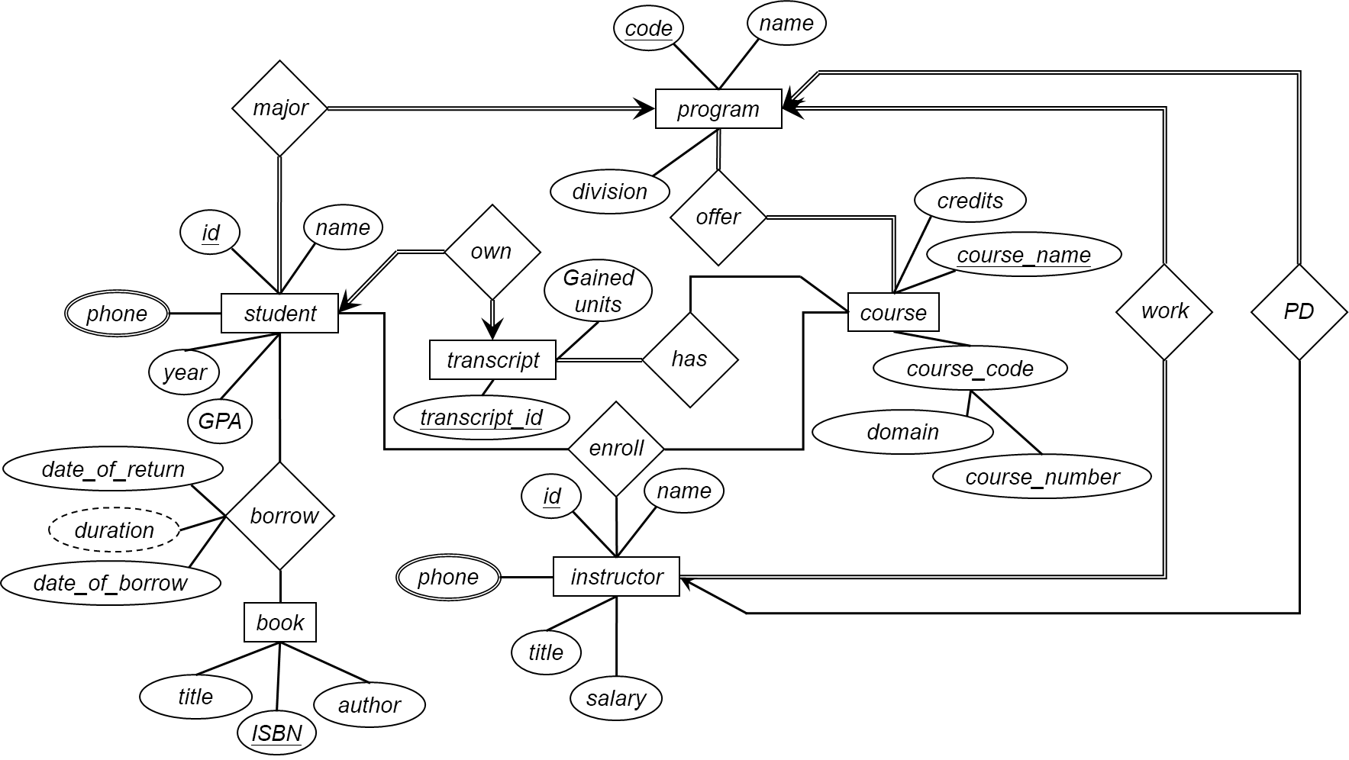
Exercises
Aggregation
Weak Entity Sets
Generalization and Specialization

Slide 20
End of Lecture 4
Aggregation
Weak Entity Sets
Generalization and Specialization

